Slide 1
Project Proposal: Developing an image classifier for recycling facilities to enhance sorting efficiency and recycled material quality. Block-C Data Modelling
Musaed Alfareh
225739

Slide 2
Project Pitch
Business Understanding
Problem Statement:
Waste sorting inefficiencies in recycling facilities result in errors and contamination, impacting operational efficiency and recycled material quality.
Main Stakeholder and Their Needs:
Stakeholders seek a solution for real-time, accurate identification of recyclable and non-recyclable items to streamline sorting processes and minimize contamination in recycling streams.

Slide 3
Project Pitch
Business Understanding
Explanation of the Idea for the Application:
The idea for the application involves developing an image classifier specifically designed for waste sorting in recycling facilities. This classifier will utilize machine learning algorithms to analyse visual characteristics of items and predict their recyclability status in real-time. By accurately identifying recyclable and non-recyclable items, the application aims to improve sorting efficiency and reduce contamination levels in recycling streams. This solution will enable recycling facility operators to make informed decisions during the sorting process, ultimately leading to higher-quality recycled materials and enhanced operational efficiency.

Slide 4
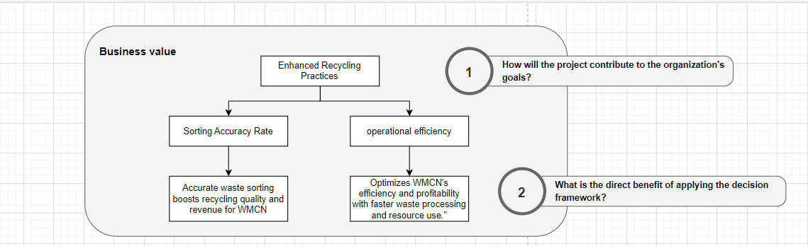
Project Pitch
Business Understanding

Slide 5
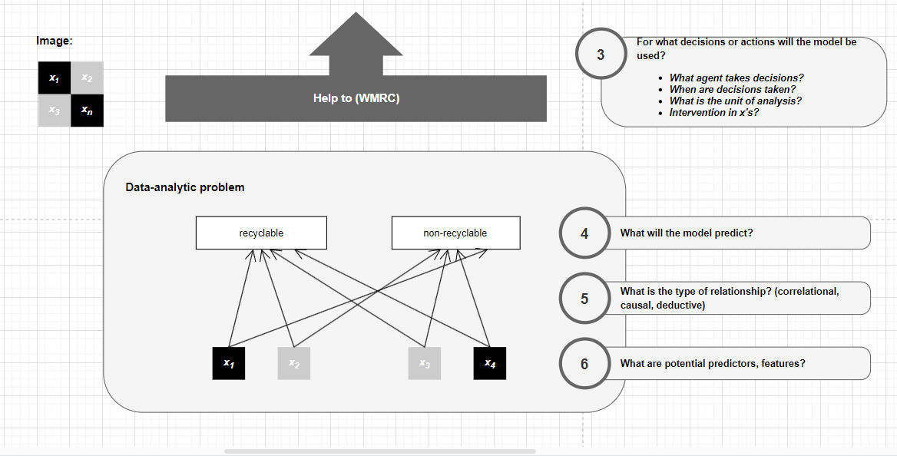
Project Pitch
Business Understanding

Slide 6
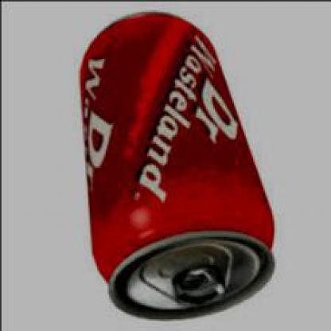
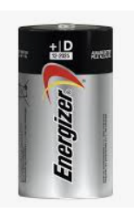
Problem Overview
Deep Learning
Explain your image classification problem:
What your model will classify?
Recyclaable and non-recyclable itmes
How many classes?
I have 2 clasess and 5 subject on each class
Show some examples of classes.
How many image per class? Around 830
Present the accuracy of the baselines (random guess, human-level performance, and basic MLP).
Time Limit: 1 minute

Slide 7
Problem Overview
Deep Learning
Explain your image classification problem:
Present the accuracy of the baselines (random guess, human-level performance, and basic MLP).
So the accuracy of the random guess is 50% and the human-level performance is 90% and the accuracy of the MLP is around 83%
Time Limit: 1 minute

Slide 8
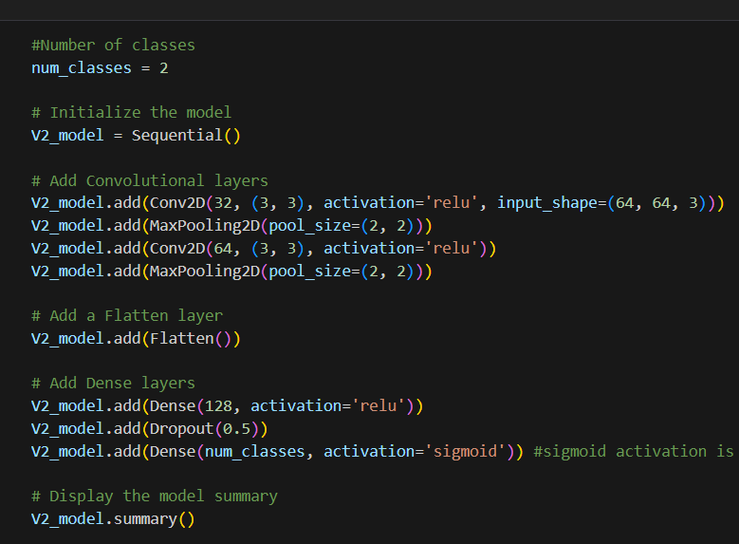
Model Overview
Deep Learning
Loading
Pre processing
Splitting
Architecture
Fitting

Slide 9
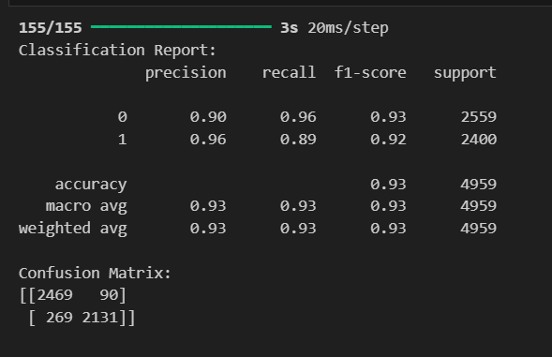
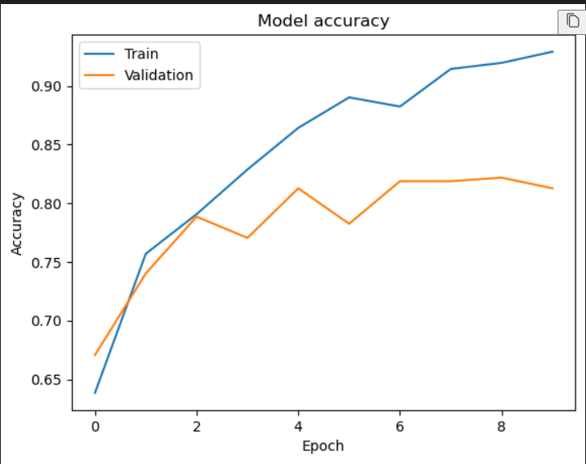
Model Performance
Deep Learning
Present the performance of your model:
Show and explain the results obtained with the final version of your model using appropriate metrics and/or plots.

Slide 10
Model Interpretability
Responsible AI
Discuss the trade-off between accuracy and interpretability:
In the context of your application, which holds greater importance: achieving a high level of accuracy or ensuring interpretability?
In my case achieving higher level accuracy is important than ensuring interpretability.
Time Limit: 2 minutes

Slide 11
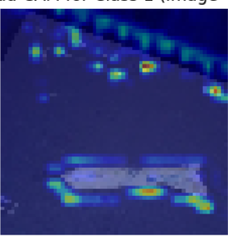
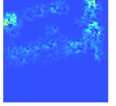
Model Interpretability
Responsible AI
What underlying pattern(s) does the model identify:
Which Explainable AI method(s) did you apply to the model?
I used vanilla saliency map and Grad-CAM
Can you provide an example of how the model recognizes specific objects, textures, or shapes within the images, employing the abovementioned method?

Slide 12
User Study
Human-Centered AI
Choose to focus on the results of your think-aloud study or your A/B test.
Briefly explain your study and the hypotheses you had
Clearly indicate how you incorporated the results in your final wireframe prototype
After I analyzed the results I came to the conclusion that the majority of the feedback given were about the UX design and the colors also adding more buttons and images and adding more pages and what I also I noticed is that all of them were admiring the overall design however with a little more slides and buttons and a good choice of color will be a strong adjustment to the overall view of the wireframe.
Time Limit: 1 minute

Slide 13
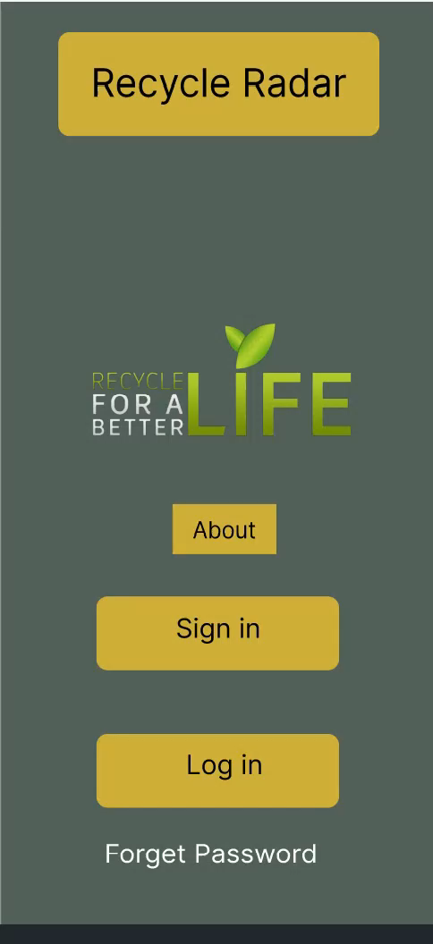
Demo
Human-Centered AI

Slide 14
Thank you!
Any questions?

